Slide 1
Lecture 1 – Introduction to Databases

Slide 2
This lecture
Introduction to the module.
Module structure.
Module outline.
Assessment.
Introduction to databases.
What is a database?
Flaws of file-based approach.
Database basics.
Benefits of database approach.

Slide 3
Why study Databases?
We live in a database world!
Basic or advanced knowledge of it is useful.
Big demand in industry.
Virtually anything needs a database!
A lot of research in academic area.

Slide 4
Introduction to databases
What is a Database?
Importance of Integration

Slide 5
What is a Database?
Simplified definition: A database is a (computer-based) record-keeping system.

Slide 6
Examples of database applications
Buying something at the supermarket.
Paying by your credit card.
Withdrawing money from the cash machine.
Booking a holiday at the travel agents.
Using the library.
Studying at university.
etc.

Slide 7

File-based systems
Application programs perform services for the end users (e.g. reports).
Each program defines and manages its own data.
Data are kept in flat files.
Definition of the data file
Stock-No | Description | Re-order-level | Unit-cost
Data file
1 | Apple Keyboard | 10 | £15
2 | Microsoft Keyboard | 10 | £5
.. | .. | .. | ..
.. | .. | .. | ..
.. | .. | .. | ..
.. | .. | .. | ..
Disk
d

Slide 8
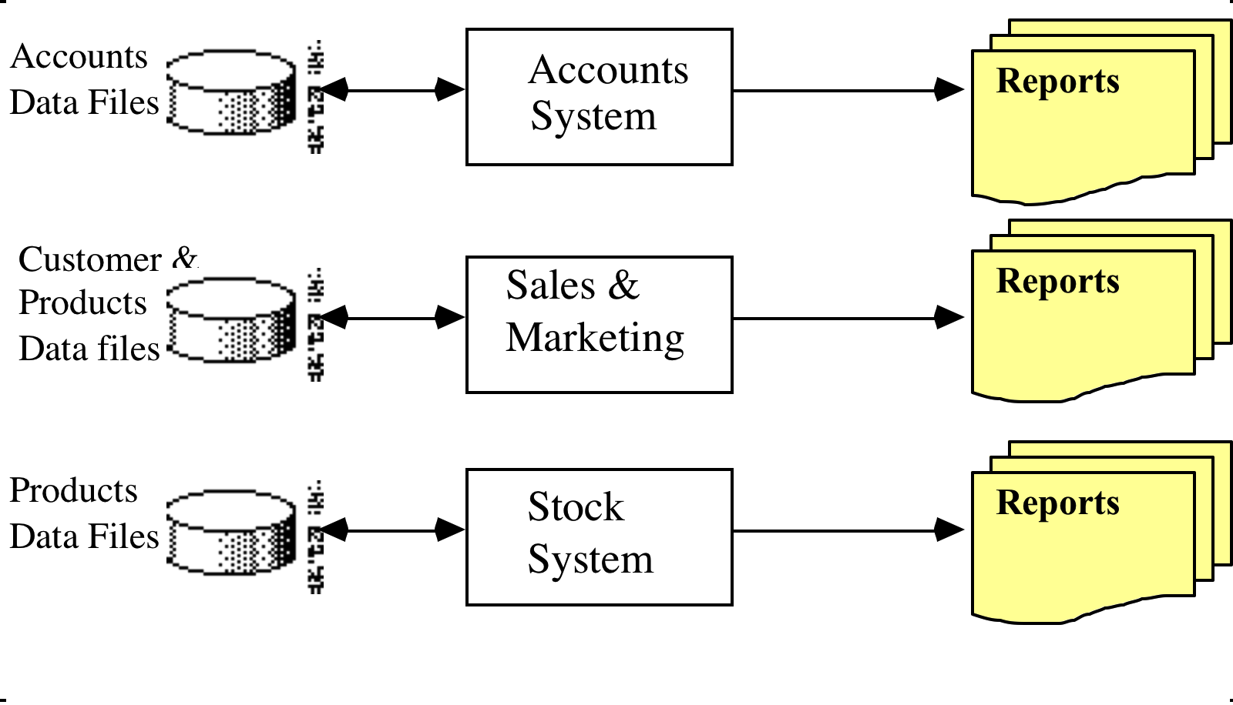
File-based systems (2)

Slide 9
Problems of the separate file-based approach
Assume that Company X needs an application which uses some data files
Stock-No | Description | Re-order-level | Unit-cost
Application
1 | Apple Keyboard | 10 | £15
2 | Microsoft Keyboard | 10 | £5
.. | .. | .. | ..
.. | .. | .. | ..
.. | .. | .. | ..
.. | .. | .. | ..
Stock data
Order details
Customer data
Disk
d

Slide 10
Problems of the separate file-based approach (2)
Assume that Company X needs an additional application which uses the same data files
Method 1: Data files are copied for the new application.

Slide 11
Problems of the separate file-based approach (3)
New Application
Application
Stock data
Order details
Supplier details
Stock data
Order details
Customer data

Slide 12
Problems of the separate file-based approach (4)
Separation and isolation of data
Each program maintains its own set of data.
Users of one program may be unaware of potentially useful data held by other programs.
Duplication of data (data redundancy)
Same data is held by different programs.
Wasted resources (disk space).
Potentially different values and/or different formats for the same item.

Slide 13
Problems of the separate file-based approach (5)
Method 2: The applications share the data files
Application
New Application
Supplier data
Stock data
Order data
Customer data

Slide 14
Problems of the separate file-based approach (6)
However: New App might need different file structures and
The programmer might change record structure to accommodate this requirement .
Application
New Application
Supplier data
Changed stock data file
order data file
Customer data

Slide 15
Problems of the separate file-based approach (7)
Stock No | Description | Re-order level | Unit Cost
Stock No | Item brand | Item type | Re-order level | Unit cost
Application
New Application
Supplier data
Changed stock data file
order data file
Customer data
1 | Apple | Keyboard | 10 | £15
2 | Microsoft | Keyboard | 10 | £5
.. | .. |  | .. | ..
.. | .. |  | .. | ..
.. | .. |  | .. | ..
.. | .. |  | .. | ..

Slide 16
Problems of the separate file-based approach (8)
Old application sees different files and refuses to work!
Application
New Application
Supplier data
Changed stock data file
order data file
Customer data

Slide 17
Problems of the separate file-based approach (9)
Program-data dependence
File structure is defined in the program code.
Typically we have many applications
Programs are written in different languages by different people, and so cannot easily access each other’s files.
Inflexibility in data queries
Programs are written to satisfy particular functions.
Any new requirement needs a new program.

Slide 18
Solution: The database approach
The data are stored so that they are independent of programs.
Program-data independence.
Database provides an integrated view of the data.
Control of data redundancy.

Slide 19
The file-based approach

Slide 20
The database approach
Reports
Database
Account System
Sales & Marketing System
Reports
DBMS
Reports
Stock Control System

Slide 21
Why use databases?
Databases integrate information.
The essence of a database is that the files are integrated into something that is more than the sum of its parts.
A properly designed database only stores information once.
Allows all applications and users to see the same information in their own way.
A centralised resource (e.g. for a company).
Persistence and permanent storage.
Simplifies backup and other maintenance.

Slide 22
Importance of integration Example
It is relatively straightforward to build an application having its own set of dedicated files.
Consider a manufacturer wishing to automate its stock control system who might construct a stock file containing the following data items:
Stock-No, Description, Re-order-level, Unit-cost
Now consider the sales department with an order processing system having an invoice file containing:
Cust-Name, Address, Invoice-No, Item-No, Description, Quantity, Cost, Order-value, Credit-limit
Finally, the finance department might have a credit control system using a file containing customer information:
CustomerName, Invoice-No, Order-value, Payments-received, Credit-limit

Slide 23
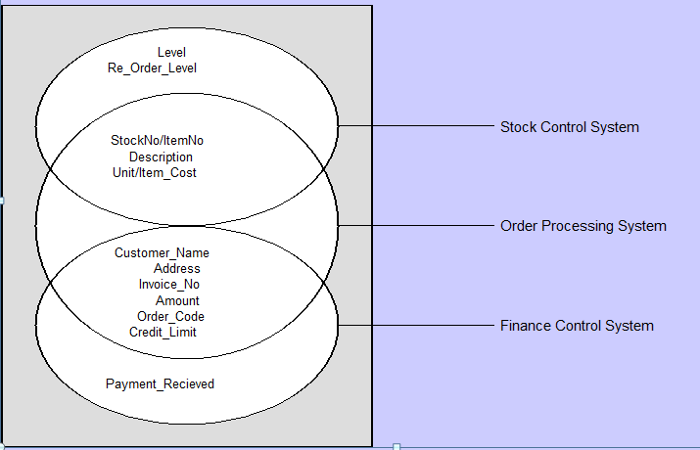
Importance of integration (2)
stock file
invoice file
Customer file

Slide 24
Importance of integration (3)
Redundancy is dangerous for the following reasons:
Ambiguity
Same thing referred to by slightly different names.
e.g. Stock-No and Item-No.
Inconsistency
Any change in pricing information must be reflected in all files containing that information – an update propagation problem.
Also, pricing data must all be of the same type.
Not e.g. a mixture of integers and character strings.
Extra work
Creating new records with data that is already stored is a waste of space and time, as well as likely to cause errors.

Slide 25
The database approach
Reports
Integrated data files
Finance Control System
Database
stock file
Order ProcessingSystem
Reports
DBMS
invoice file
Customer file
Reports
Stock Control System

Slide 26
What is a database?
Simplified definition: A database is a (computer-based) record-keeping system.

Slide 27
Database – A better definition
Database =
Collection of interrelated persistent data stored together without unnecessary redundancy to serve one or more application systems of some given enterprise in an optimal fashion.

Slide 28
Database Management System (DBMS)
Reports
Integrated data files
Finance Control System
Database
stock file
Order ProcessingSystem
Reports
DBMS
invoice file
Customer file
Program-Data Independence
Reports
Stock Control System

Slide 29
Database Management System (DBMS)
DBMS =
A software system that enables users to define, create, maintain, and control access to the database.

Slide 30
Views
Reports
Integrated data files
Finance Control System
Database
Customer file
DBMS
stock file
invoice file
Order ProcessingSystem
Reports
invoice file
Customer file
stock file
Reports
Stock Control System

Slide 31
Views
A view is essentially some subset of the database.
Allow each user to have his/her own “perspective” of the database.
Reduce complexity.
Provide a level of security.
Provide a mechanism to customise the appearance of the database.
Present a consistent, unchanging picture of the structure of the database, even if the underlying database is changed.

Slide 32
Benefits of databases
Control of data redundancy
We usually eliminate it.
Improved data consistency.
By enforcing integrity constraints.
Improved maintenance through data independence.
Better use of integrated data resources.
Data (and data model) shared across organisation.
Central data resource – managing access and security is easier.
Updates, standards, etc.
Data more accessible to end users.
Control of concurrency.

Slide 33
(Potential) disadvantages of databases
Complexity, size and cost of Database Management System (DBMS) software.
Usually not significant.
Extra hardware costs (e.g. for database servers and storage).
Stored in one place so maybe less storage overall.
Cost of conversion of legacy systems, re-training, hiring database specialists, etc.
So loads of work (jobs) for You.
Performance, compared to dedicated file-based application.
Properly designed can be even faster.
Higher impact of single failure.
So back up regularly.

Slide 34
History of database systems
First generation
Hierarchical and Network
e.g. IMS (IBM)
Second generation
Relational
e.g. DB2 (IBM), Oracle, SQL Server etc.
Third generation
Deductive
Object-Relational
e.g. newer Oracle versions
Object-Oriented

Slide 35
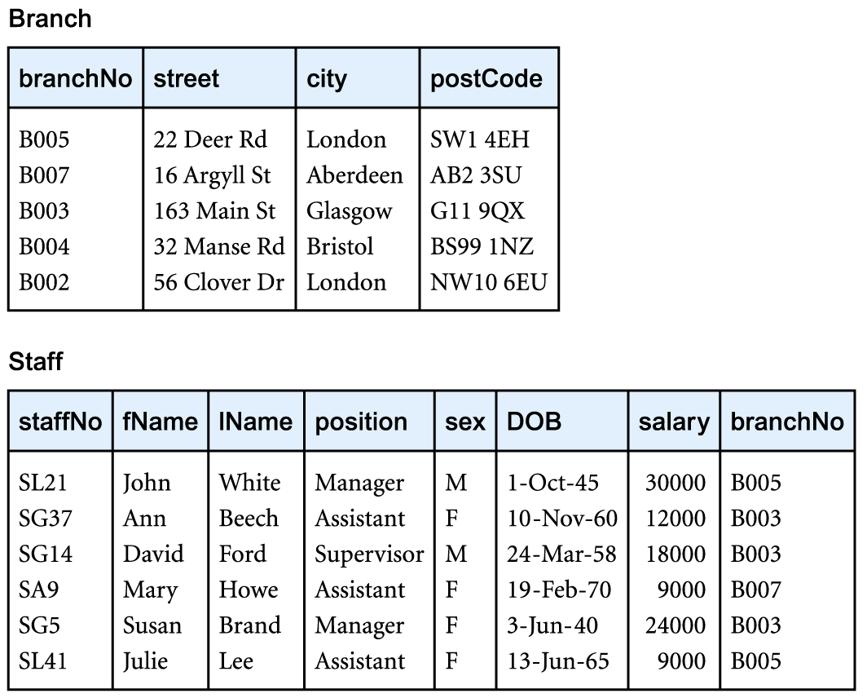
Basic concepts
A Database consists of Tables (Relations), each identified by a distinct Name.
Tables can either represent something concrete, or a link between concrete objects.
Database
Database
Two tables

Slide 36
Basic concepts
Each Table has several Rows and Columns.
The Rows in the Table are called Records.
The Columns in the Table each have a distinct Name; they define a number of named Fields (Attributes) within each Record.

Slide 37
Tables
Each Field in a Record carries a Data Item.
Each Data Item has a Data Type.
The set of all Data Item values for a given field is called the Domain of that Field.

Slide 38
Tables
Every Record in a Table must be unique.
Every Table has one or more fields which make the Primary Key of the Table. If the Primary Key of a Record is given, the Record can be uniquely identified.

Slide 39
How to design database tables
You will like to learn how to come up with the database table
It is hard task
Next Lecture

Slide 40
Summary
Database approach superior to file-based approach.
Integration, no redundancy, consistency, maintenance, concurrency.
Database concepts.
Tables, records (rows), fields (columns), primary keys (for identification of rows).
Suggested Reading:
Connolly & Begg, Chapters 1 & 2.
Date, Chapter 1.

